Slide 1
INFORMATION SYSTEMS MANAGEMENT
INTRODUCTION TO INFORMATION SYSTEMS

Slide 2
SYSTEM CONCEPTS
System definition
A system is an orderly grouping of independent components linked together according to plan to achieve a specific objective.
System is an interrelated set of business procedures (or components) used within one business unit, working together for some purpose.
For example, a system in the payroll department keeps track of checks, whereas an inventory system keeps track of supplies. The two systems are separate.

Slide 3
SYSTEM CONCEPTS
Characteristics of a system
1. Organization
Structure and order. It is the arrangement of components that helps to achieve objectives.
Example: in business organizations Hierarchical relationships starting with the director at the top and leading downward to the blue collar workers represents organization structure.
Computer system: organization of various components like input devices, output devices, CPU and storage devices to generate information.

Slide 4
SYSTEM CONCEPTS
2. Interaction
Procedure in which sub systems or the components function with each other.
In an organization, purchasing must interact with production, advertising with sales and payroll with personnel.
In a computer system the CPU must interact with other units to solve a problem. On the other hand the main memory holds the data that has to be operated by the ALU. The interrelationships of all units enables the computer to function

Slide 5
SYSTEM CONCEPTS
3. Interdependence
Independence means that components of a computer system or organization depend on one another. They are coordinated and linked together in a planned way to achieve an objective.
4. Integration
How subsystems are tied together to achieve the system objective. It means that parts of a system work together within the system even though each part performs a unique function. Successful integration produces a better result as a whole rather than each component working independently.

Slide 6
SYSTEM CONCEPTS
5. Central Objective
Central objective means the common goal. Objectives may be real or stated.
Although a stated objective may be real, it is quite common that an organization may state one objective and operate to achieve another.
The most important objective is that users must be aware about the central objective well in advance.

Slide 7
SYSTEM CONCEPTS
Types of Systems
Physical or Abstract System
Physical system are tangible entities which are static or dynamic in nature
Abstract systems are conceptual or non-physical entities. They may be formulas, representation or model of a real system.
A computer system has hardware components which are static and software components which are dynamic.
Programs, data, and applications can change according to the user's needs.

Slide 8
SYSTEM CONCEPTS
Open and Closed Systems
Majority of systems are open systems. An open system has many interfaces with its environment and permits interactions across its boundaries.
It can also adapt to changing environmental conditions
It can receive inputs from, and delivers output to the outside of system
Closed systems: Systems that don't interact with their environment. Closed systems exist in concept only. Completely closed systems are very rare.

Slide 9
SYSTEM CONCEPTS
Deterministic & probabilistic systems:
Deterministic system: It is a system which operates in predictable manner.
Stepwise execution is always possible & output is sure. For example: computer system.
Probabilistic system: It is a system which operates in unpredictable manner & degree of error is always possible.
Here occurrence of an event cannot be perfectly predicted. Also output is not sure. An example is s warehouse and its contents.

Slide 10
SYSTEM CONCEPTS
Man-made Information System
Information system is the basis for interaction between the user and the analyst.
It determines the nature of relationships among decision makers and is viewed as a decision center at all levels
Main purpose-manage data for a particular organization.
Man-made Information Systems are further categorized into:
Formal Information Systems
Informal Information Systems
Computer-Based Information Systems

Slide 11
SYSTEM CONCEPTS
Formal Information Systems: It is based on the organization represented by the organization chart. Responsible for flow of information from top management to lower management. It is concerned with the pattern of authority, communication and workflow. Feedback can be given from lower authorities to top management
Informal Information Systems: Informal systems are employee based. These are made to solve the day to day work related problems. It can funnel information upward through indirect channels. It is considered useful because it works within the framework of the business and its stated policies

Slide 12
SYSTEM CONCEPTS
Computer-Based Information Systems: This class of systems depends on the use of computer for managing business applications. Different information systems are developed to meet a variety of business needs.
Information systems (IS) in organizations capture and manage data to produce useful information that supports an organization and its employees, customers, suppliers, and partners.
Many organizations consider Information systems to be essential to their ability to compete or gain competitive advantage.
Most organizations have come to realize that all workers need to participate in the development of information systems.
Information systems in organizations encompass transaction processing systems, management information systems, decision support systems, and strategic information systems.

Slide 13
INFORMATION SYSTEMS
Information System is any organised combination of people, hardware, software, communication networks, and data resources that collect, transform and disseminates information in an organisation.
Information systems is interrelated components working together to collect, process, store and disseminate information to support decision making, co-ordination, control, analysis and visualisation in an organisation.

Slide 14
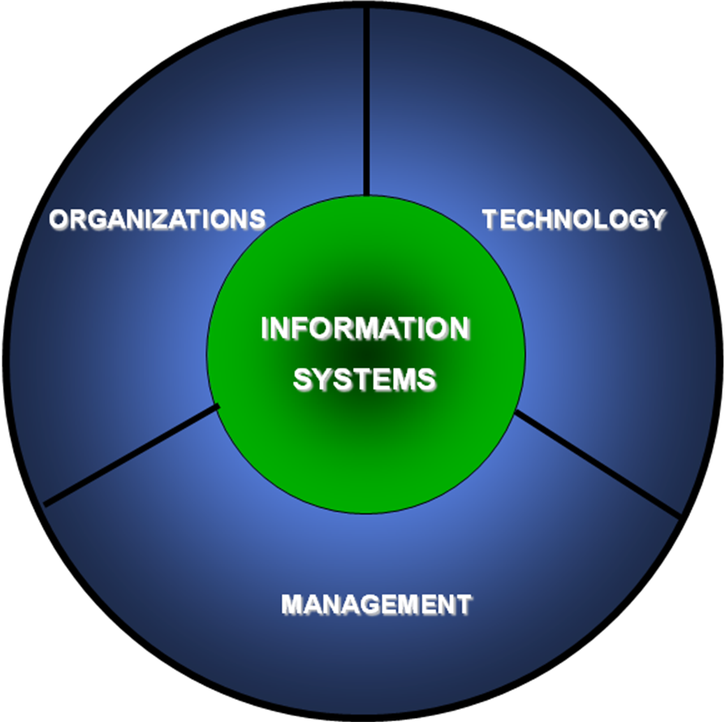
INFORMATION SYSTEMS
A Business Perspective on Information System
From a business perspective, an information system is an organizational and management solution, based on information technology, to a challenge posed by the environment.

Slide 15
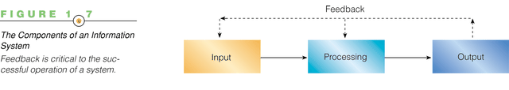
INFORMATION SYSTEMS
ACTIVITIES OF AN INFORMATION SYSTEM TO PRODUCE INFORMATION

Slide 16
INFORMATION SYSTEMS
The following activities of information systems produce information that organizations need;
Input: Captures raw data from organization or external environment
Processing: Converts raw data into meaningful form
Output: Transfers processed information to people or activities that use it
Feedback: Output returned to appropriate members of organization to help evaluate or correct input stage

Slide 17
INFORMATION SYSTEMS
Computer-based information systems (CBIS) use computer technology to perform some or all of their tasks and are composed of:
Hardware – are the tangible parts of a computer based information system. These are the physical resources that perform the required computing tasks such as data gathering or input, data output, data processing and storage.
Software - programs and their documentations that govern the operation of the computer. There are Systems software, applications software, programming utilities and programming languages.
Database - an organized collection of facts and information, typically consisting of two or more related data files.

Slide 18
INFORMATION SYSTEMS
People (Users) - important element, people element can be categorized as users and professionals. Users include the systems processes and people.
The people provide the skills needed to develop, design, implement and manage the IT systems. People also serve as the customers for the IT services and products, suppliers to the IT business, owners of the IT systems, etc.
The system processes also serve as users to other processes. Processes need to communicate and pass relevant data to one another during processing. Some most common roles played by people include:-
Systems Analyst
Programmer
Technician
Engineer
Network Manager
MIS (Manager of Information Systems)
Data entry operator

Slide 19
INFORMATION SYSTEMS
Procedures –include the strategies, policies, methods, and rules for using the CBIS.
Telecommunication System/Communication network
The electronic transmission of signals for communications, through networks - used to connect computers and computer equipment to enable electronic communications. Internet - the world’s network consisting of thousands of interconnected networks

Slide 20
INFORMATION SYSTEMS
Valuing Information Systems
Information systems can be used in three ways to add value to an organization:
Automating
Informating
Strategizing

Slide 21
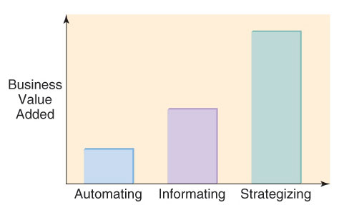
INFORMATION SYSTEMS
Valuing Information Systems

Slide 22
INFORMATION SYSTEMS
1. IS for Automating: Doing Things Faster
With automation, tasks can be completed:
Faster
Cheaper
More accurately
With greater consistency
Automating example: Loan processing comparison for 3 methods (from the moment the customer takes the application until the applicant is notified of decision)
Manual loan process – 25 to 40 days
Technology-supported process – 5 to 20 days
Fully automated process – 1 hour to 15 days

Slide 23
INFORMATION SYSTEMS
2. IS for Organizational Learning (Informating): Doing Things Better
Information systems can also be used to:
Learn about processes
Improve processes
Support organizational learning
Informating example: Computer-based loan system identifies peak times during the year when specific loans are processed.
3. IS for Supporting Strategy: Doing Things Smarter
IS used to gain or sustain competitive advantage
Turning benefits of automating and informating into strategic advantage
How do you identify Opportunities/Problems? Use Porter’s Value Chain Model and Five Forces Model

Slide 24
INFORMATION SYSTEMS
Why Organizations Build Information Systems
The following are some benefits for organizations building information systems:
More efficient.
Save money.
Reduce work force.
Become important and to stay in business.
A source of competitive advantage.
More innovative than others.
Satisfy the ambitions of various groups within an organization.

Slide 25
INFORMATION SYSTEMS
Functions of an information system
The functions of an information system can be generally classified into those functions involved in:
Transaction processing
Management reporting
Decision support

Slide 26
INFORMATION SYSTEMS
1. Transaction processing
Major processing functions include:
Process transactions – Activities such as making a purchase or a sale or manufacturing a product. It may be internal to the organization or involve an external entity.
Maintain master files – Many processing activities require operation and maintenance of a master file, which stores relatively permanent or historical data about organizational entities. E.g. processing an employee paycheck needs data items such as rate of pay, deductions etc. transactions once processed will update data items in the master file to reflect the most current information.
Produce reports – reports are significant products of an information system. Scheduled reports are produced on a regular basis. An information system should also be able to produce special reports quickly based on ‘ad hoc’ or random requests.

Slide 27
INFORMATION SYSTEMS
Transaction processing cont’d
Process inquiries – Other outputs of the information system are responses to inquiries using the databases. These may be regular or ad hoc inquiries.
Process interactive support applications – The information system contains applications to support systems for planning, analysis and decision making.
- The mode of operation is interactive, with the user responding to questions, requesting for data and receiving results immediately in order to alter inputs until a solution or satisfactory result is achieved.

Slide 28
INFORMATION SYSTEMS
2. Management reporting
This is the function involved in producing outputs for users. These outputs are mainly as reports to management for planning, control and monitoring purposes. Major outputs of an information system include:
Transaction documents or screens
Preplanned reports
Preplanned inquiry responses
Ad hoc reports and ad hoc inquiry responses
User-machine dialog results

Slide 29
INFORMATION SYSTEMS
3. Decision support
Types of decisions
Structured/programmable decisions
Semi-structured/semi-programmable decisions
Unstructured/non-programmable decisions

Slide 30
INFORMATION SYSTEMS
1. Structured/programmable decisions
These decisions tend to be repetitive and well defined e.g. inventory replenishment decisions.
A standardized pre-planned or pre-specified approach is used to make the decision and a specific methodology is applied routinely.
Also the type of information needed to make the decision is known precisely.
They are programmable in the sense that unambiguous rules or procedures can be specified in advance. These may be a set of steps, flowchart, decision table or formula on how to make the decision.
The decision procedure specifies information to be obtained before the decision rules are applied. They can be handled by low-level personnel and may be completely automated.

Slide 31
INFORMATION SYSTEMS
Structured decisions cont’d
It is easy to provide information systems support for these types of decisions.
Many structured decisions can be made by the system itself e.g. rejecting a customer order if the customer’s credit with the company is less than the total payment for the order.
Managers must be able to override these systems’ decisions because managers have information that the system doesn’t have e.g. the customer order is not rejected because alternative payment arrangements have been made with the customer.
The system might also make only part of the decision e.g. quantities of each inventory item to be re-ordered. The manager may then select the most appropriate vendor for the item on the basis of delivery lead time, quality and price.
Examples of such decisions include: inventory reorder formulas and rules for granting credit.

Slide 32
INFORMATION SYSTEMS
Semi-structured/semi-programmable decisions
The information requirements and the methodology to be applied are often known, but some aspects of the decision still rely on the manager:
An example is selecting the location to build a new warehouse. Here the information requirements for the decision such as land cost, shipping costs are known, but aspects such as local labour attitudes or natural hazards still have to be judged and evaluated by the manager.

Slide 33
INFORMATION SYSTEMS
Unstructured/non-programmable decisions
These decisions tend to be unique e.g. policy formulation for the allocation of resources.
The information needed for decision-making is unpredictable and no fixed methodology exists.
Multiple alternatives are involved and the decision variables as well as their relationships are too many and/or too complex to fully specify. Therefore, the manager’s experience and intuition play a large part in making the decision.
In addition there are no pre-established decision procedures either because:
The decision is too infrequent to justify organizational preparation cost of procedure
The decision process is not understood well enough, or
The decision process is too dynamic to allow a stable pre-established decision procedure.
Example: Selecting a CEO of a company.

